Slide 1

Practical steps towards a more inclusive practice
Stéphanie Krus
11 June 2026

Slide 2
What I will take you through
improve accessibility of your design
take digital inclusion into account
have a more inclusive practice
focus the research on some groups
key takeaways
Notes:
In this session, I’ll present practical steps to integrate to your practice to improve the accessibility of your design
I’ll explain why and how you can take digital inclusion into account
I’ll give some simple recommendations to have a more inclusive practice with your team, your stakeholders and your research and design participants
And I’ll tell you about a time where I focussed our research on a few groups which gave us the most valuable insights and how this might be an option for you too.
Finally, I’ll recap and give you some takeaways

Slide 3
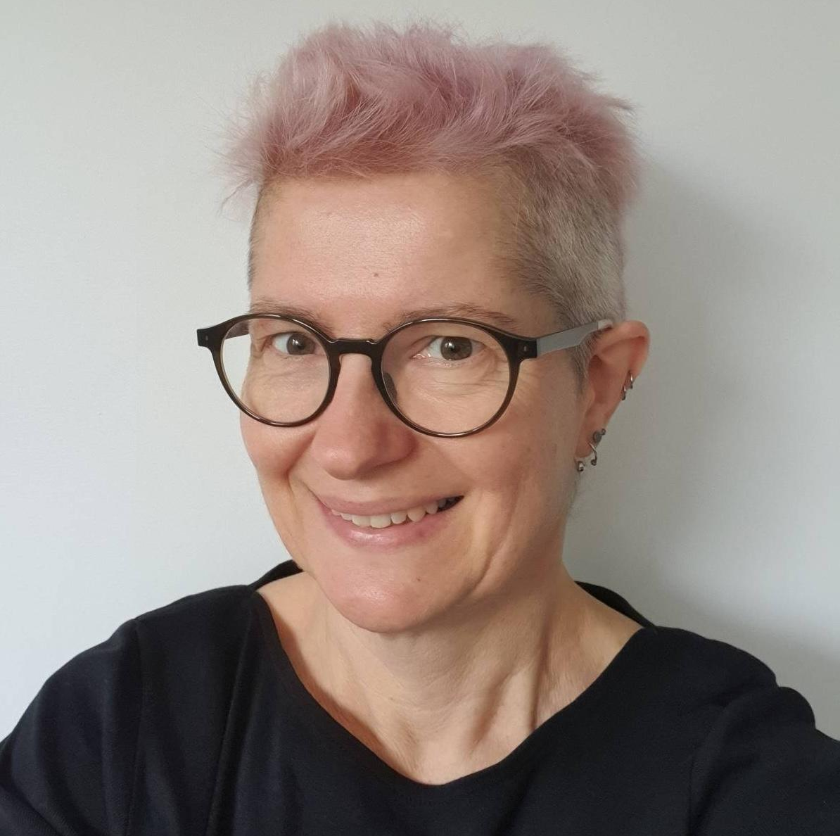
About me
I’m a service designer
my pronouns are she/her
very keen on accessibility and inclusion

Slide 4
Accessibility

Slide 5





1 in 4 people are disabled in the UK
vision hearing speech motor cognitive
It’s different for everyone
Notes:
1 in 4 people are disabled in the UK
A disability can affect your vision, your hearing or your speech.
It can be a physical disability​ or a cognitive disability​,
this means it affects your memory, ​or how you process things, communicate and think​.
It can also be a mix of more than one disability​.
In fact,it’s quite frequent that people have more than one disability
and they are not always visible to others.
It’s different for everyone
Source for 1 in 4 - disability prevalence by age group

Slide 6
Defining accessibility
“Accessibility means that people can do what they need to do in a similar amount of time and effort as someone that does not have a disability.
It means that people are empowered and can be independent”
Source: GOV.UK Blog post

Slide 7

Neurodiversity
Dyslexia
Autism
ADHD (= Attention Deficit and Hyperactivity Disorder)
Dyspraxia
Dyscalculia
OCD (Obsessive Compulsive Disorder)
Tourette’s syndrome and more
Notes:
The image on the slide is the infinity symbol with rainbow colours, and this is the symbol for neurodiversity.
Neurodiversity is an umbrella term

Slide 8
How neurodiversity affects people
think, process information and language
interact socially and communicate with others
perceive space and time

Slide 9
1 in 7 people are neurodivergent in the UK
This is about 15 to 20% of the general population
But it’s often underestimated and under-declared.
It’s much higher for people working in Tech.
→ above 20% and probably up to 50% in tech and the creative industry
Notes:
1 in 7 people are neurodivergent in the UK - that’s about 15 to 20 % of the general population.
It’s often underestimated and under declared because even though things are improving, it’s still often perceived negatively, so people are wary of disclosing.
These numbers are much higher for people working in tech.
It’s hard to have reliable numbers, I’ve got 3 sources which I added to the notes of the slide.
And some of the numbers are showing that it’s above 20% in tech and the creative industry and probably up to 50% in some cases.
So if you consider the people in your team, it’s very likely that quite a few are neurodivergent.
I’ll come back to this at the end when talking about inclusion within your team.
Major new report from the Tech Talent Charter reveals tech employers massively underestimate neurodivergence - We are Tech women (Feb 2024)
What it’s like being neurodivergent in the creative industries - Creative review (Avril 2024)
Written evidence given to a UK Parliament committee (PDF)

Slide 10
Accessibility:
The basics
Notes:
There is a false belief that making your design accessible requires more time, more money and technical expertise.
But actually, there are lots of very basics things you can do as designer to avoid a lot of accessibility issues
This is what I’m going to show you in this part.

Slide 11
State of digital accessibility - WebAIM survey
WebAIM - Looked at the top 1 million websites’ homepage:
56 errors per homepage on average
about 96% did not comply with WCAG 2.2
Source: WebAIM Million (February 2026)
Notes:
Digital accessibility is progressing.
A lot of companies and organisations are trying to do better but it’s often still pretty poor.
WebAim - this stands for Web accessibility in mind - does an evaluation every year since 20-19,
they look at the homepages for the top 1 million websites.
This year, they found that there were about 56 errors per page on average, which is not very different from the previous years.
About 96% of these homepages do not comply with WCAG
WCAG stands for Web Content Accessibility Guidelines and is a standard for digital accessibility.

Slide 12
Most errors are not that hard to fix
84% of the pages had low contrast text errors
53% have missing alternative text for images
46% have empty links
Notes:
Most of these errors are not that hard to fix
84% of the pages had low contrast text errors, this is when the colour of the text is not contrasted enough with the background. There are many tools to help you with this
53% have missing alternative text for images or diagrams, this is the text description which will appear if your image doesn’t load or which will be read by a screen reader for people who cannot see your image, again there is a lot of guidance to help you learn how to write good alternative texts
46% of the pages have empty links, this is when you use an icon for a link for example, like the social media icon in the footer of your website

Slide 13
Simple things you can do
check colour combinations
give images an alt text
same for empty links (like your social media icons in the footer)
use plain English
respect the headings order H1, H2, H3, H4…
make the text of your link meaningful
Notes:
Some simple steps will fix around 90% of the issues found in the survey.
You should check colour combinations, are they contrasted enough?
give images and diagrams an alternative text
same for empty links, if you give an alt text to the icon used as link, then a screen reader will say where this link is taking you
use plain English, avoid jargon, and use simple words
respect the headings order H1, H2, H3, H4…don’t skip a level
make the text of your link meaningful, so instead of ‘Read more’ you could have ‘read more about the result of this survey’ for example

Slide 14
Fonts and layout
DON’T WRITE IN ALL CAPS
avoid italics and fancy fonts
align left and do not justify your text
Notes:
Regarding fonts and layout,
Do not do what I did on the first line: when you write in all caps, you lose the shape of the words, which slows down people reading, in particular dyslexic people.
When people use screen readers, it is sometimes interpreted as an acronym, and the letters might be announced one by one which is annoying.
Avoid italic and fancy fonts too because it’s also harder to read for many people
You should align your text on the left to help people find the start of the next line. If you don’t, it gets harder, especially for people magnifying their screen
Justifying your text is also problematic because this means the space between words will vary, and that also makes it harder to read.

Slide 15
Resources about accessibility
for Alt text, this guidance by WebAIM
W3C Foundations Online Course
videos: Accessibility Scotland conference and Inclusive Design 24 online and free
DWP Accessibility manual
Estimate how many people using your website might be disabled

Slide 16
Accessibility:
Colours

Slide 17
Make sure your contrast are good
text, button, links, icons, navigation items
hover states, visited links, error messages
check dark mode!

Slide 18
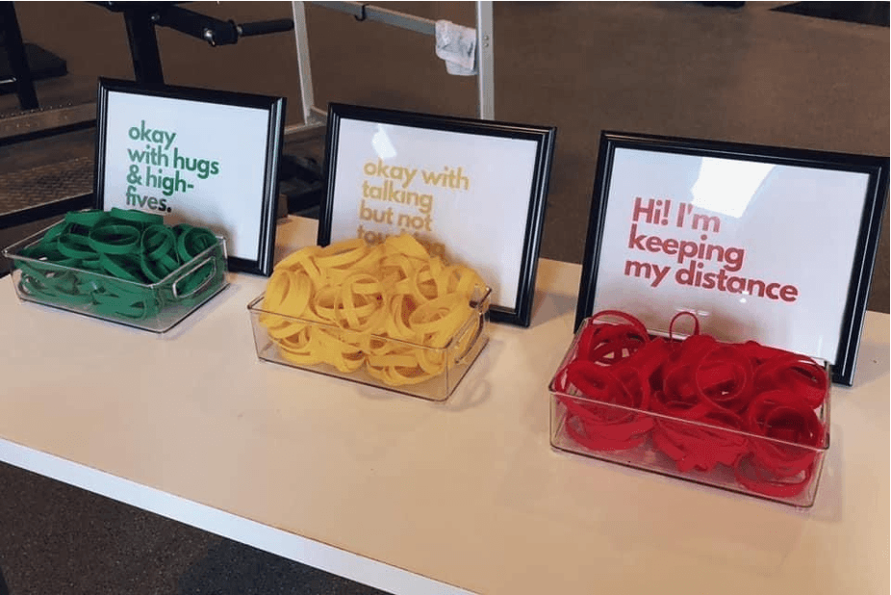
Don’t rely on colour alone (1)
Notes:
You might have seen this image in social media?
you have 3 boxes of elastic bands with a sign each, with green ones and a sign saying: “ok with hugs”, a box of orange ones with a sign saying “:ok talking but no touching” and a box of red elastic bands and a sign saying: “I'm keeping my distance”
I’m sure many of you here, think this is a good idea. And it is, as people can immediately see how close they can get to you. Unless they are blind or cannot see colours…

Slide 19
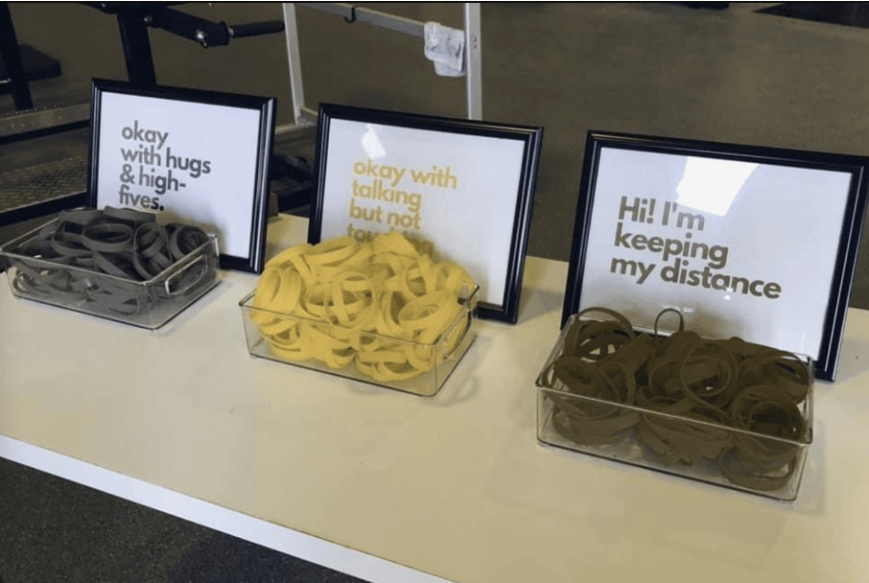
Don’t rely on colour alone (2)
Notes:
Now this is the same image but how it would be seen by some type of colour-blind people,
The initial green (which was for ok with hugs) looks very similar to red (which is for I'm keeping my distance)
So for people who can’t see colours, there are a few things you could do, on elastic bands, you could potentially have some text, if you’re using a lanyard, then you could add stripes, or dots etc
You should keep this in mind for your error messages - but also your buttons, the colour of your links, icons and any colour code you use in a spreadsheet for example.
Do no use colour alone to convey an information, you need to have a back up
There are simulators for colour blindness but you should not base your colour choices on them, just assume some people don’t see colours at all and have another way to convey any information with an alternative.

Slide 20
Dyslexia vs low vision
Light cream background and dark blue text is better for some dyslexic people.
But high contrast can be better for some people with low vision.
Notes:
Keep in mind that people might change the colours. One of the reasons is dyslexia or visual stress impairment. Some colours or filters will help them read better
On the left, the pale cream background and dark blue text, seems to be something which helps some dyslexic people (not all of them)
On the right this is high contrast which is better for some people with low vision, so they might also change your colours

Slide 21
There is no perfect solution
“User needs vary widely across people who have low vision, and one user’s needs may conflict with another user’s needs.”
Accessibility Requirements for People with Low Vision, W3C

Slide 22
Resources about colours
Contrast checkers with suggestions: Accessible colours
From a colourblind designer to the world: Please stop using red and green together
How to use color blind friendly palettes to make your charts accessible
Supporting users who change colours on GOV.UK and a presentation by Oliver Byford (Google slides)
Notes:
Accessible colors is one tool among many others to test your contrast, this one will tell you if you fail WCAG or not and if you fail it will offer alternative colour codes to pass

Slide 23
Accessibility:
Simple tests to do
Notes:
There are simple tests you should do when you are designing websites, because people might not be using your website the way you are expecting them to

Slide 24
People might use your website in a way you didn’t expect
A dyslexic person might use a screen reader
Someone might be using a switch or their voice to interact
A person might be zooming or use a large mouse pointer
Notes:
A dyslexic person might use a screen reader even though they can see
Someone with a motor impairment might be using a switch or their voice to interact, instead of a keyboard, or a mouse
A person with low vision might be zooming to see or use a large mouse pointer

Slide 25
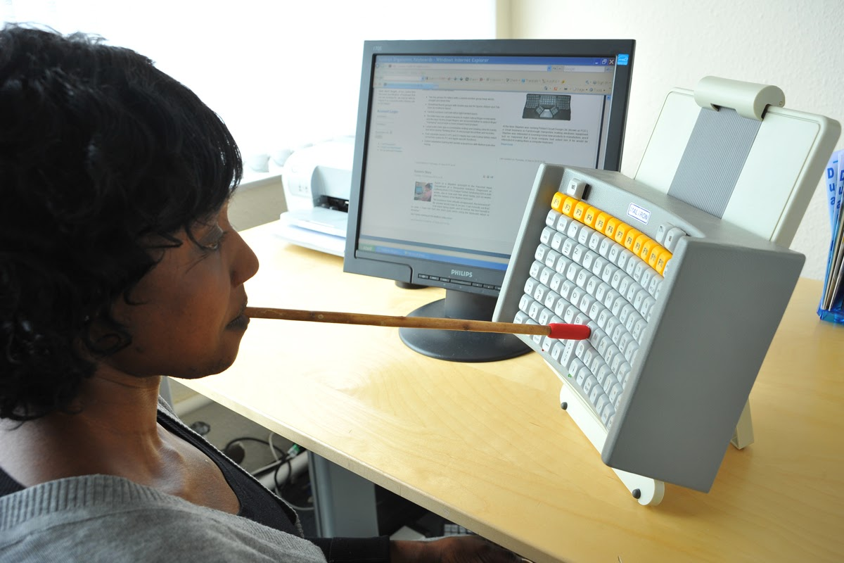
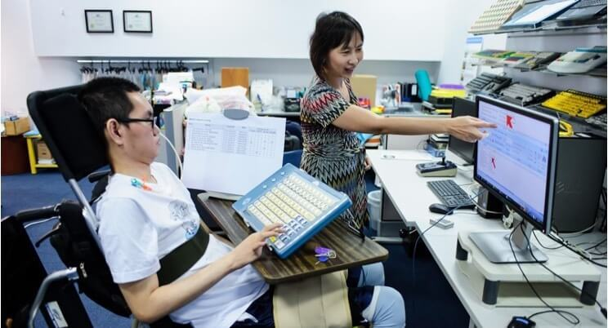
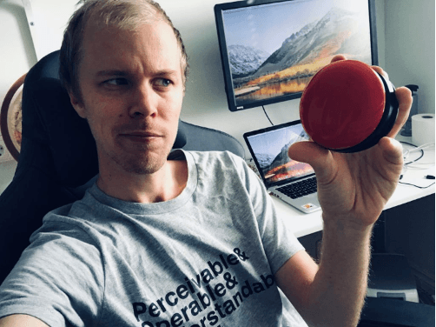
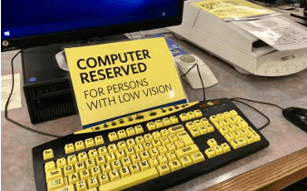

Examples of assistive tech
Notes:
For those of you unfamiliar with assistive technologies, I’ve put some examples on this slide:
you have a person using a mouth stick to use a keyboard,
a man holding a switch which is a tool to help you navigate a website or an app, this one is round
someone using a Braille keyboard
and a special keyboard for people with low vision
Photos from these websites: https://shaylanassistivetechnology.weebly.com/computer-access-supports.html
https://www.ergocanada.com/detailed_specification_pages/maltron_keyboards_mouth_head_stick_keyboard.html
http://www.designhub.it/smartdesign/2017/09/24/design-assistive-technology-equipments-auxiliary-performance-everyday-life-activities-elderly-disabled-people-socially-institutionalised_majorthesis_gruppo04/
https://www.24a11y.com/2018/i-used-a-switch-control-for-a-day/
https://www.worthingtonlibraries.org/sites/default/files/styles/teaser_standard/public/images/promotions/Assistive%20Technologies.jpg?h=4915d655&itok=Ic-yV5zf

Slide 26
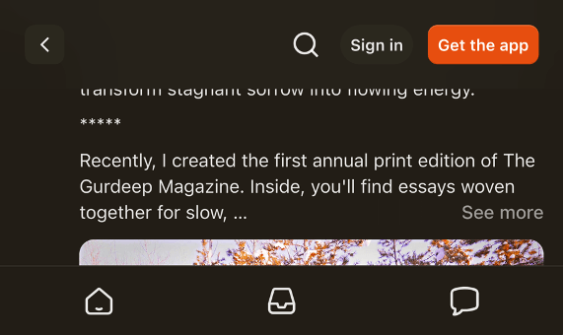
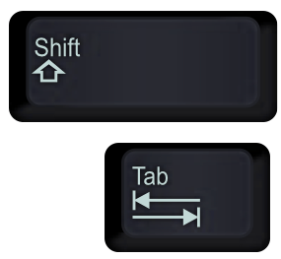
2 simple tests you should do
Keyboard only navigation
Use the Tab key to move forward
Shift + tab key to move back
Zoom at 400%
Use the Ctrl and + keys
Notes:
If you create websites there are 2 simple tests you should do:
Test Keyboard only navigation: don’t use your mouse and instead, use the Tab Key to move forward and Shift plus the tab key to move back.
Can you still navigate your website in a way that makes sense and allow you to access everything?
Zoom at 400% - On the slide I’m showing Substack, which do not care much about accessibility so no surprise, it’s very hard to use with a sticky footer and a sticky header so not much space in between to read anything
it would be equally bad on Amazon forcing you do scroll horinzontally and you would get lost very quickly.
Doing these 2 tests will help you pick up some issues - so do get in the habit.
But also make sure to test with disabled people.

Slide 27
Resources about assistive technologies
How a screen reader user (Leonie Watson) surf the web - video
Assistive technologies testing (DWP Accessiblity manual)
How to start testing screen reader support using VoiceOver
Videos of people with disabilities using tech by AxessLab

Slide 28
Accessibility:
Other

Slide 29
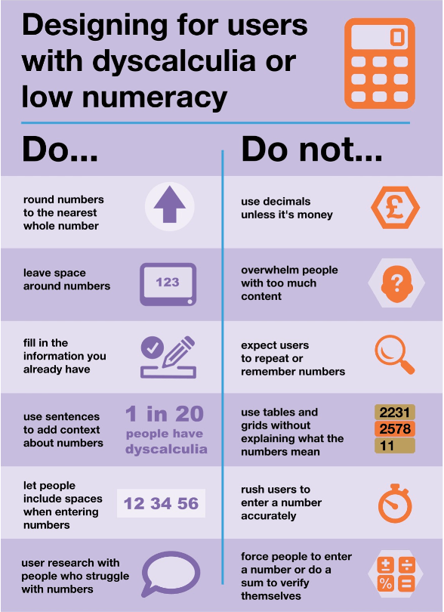
Numbers
Low numeracy affects half the working-age adults in the UK
Accessible numbers project
by Laura Parker
Notes:
Are you displaying a lot of numbers in your design?
Did you know that low numeracy affect half the working-age adults in the UK?
Check the Accessible numbers project by Laura Parker, and the poster Laura worked on with Rachel Malic and Jane McFadyen.
These 3 content designers who came up with a do and don’t poster for designing for people with dyscalculia or low numeracy which I’m showing on this slide
link to a blogpost explaining how they made this poster
The accessible number project has advice and podcast episodes for you to learn more about the problems and how to do better.

Slide 30

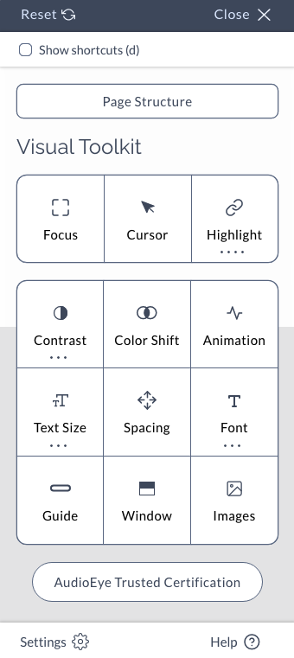
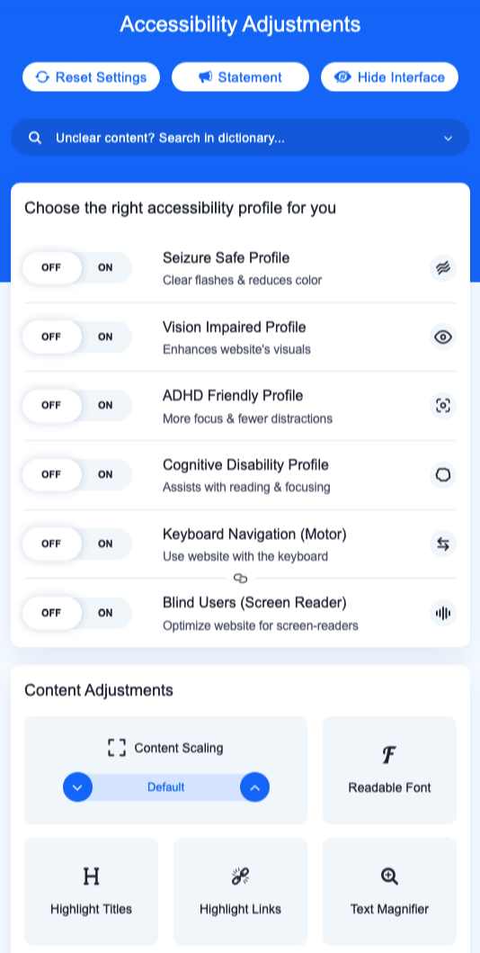
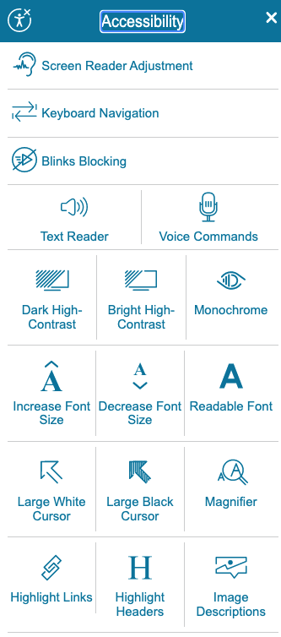
Do NOT use accessibility overlays
Overlay Fact Sheet
Notes:
One thing that might tempt you as an easy way to fix accessibility issues is using an accessibility overlay
I’ve put some illustrations on this slide if you are not familiar with this.
On the websites using them, you will first need to find where to enable them as it’s often not easy to find,
it might be a floating icon with a symbol for accessibility and then a very busy menu will appear, with a multitude of options to choose from.
Most of them are things your device or your browser offers anyway.
A lot of people still thinks they can make their website accessible once it’s all done and ready to go live.
You can be sued if your website is not accessible, so when someone tells you they can fix it with an overlay, it’s sounds too good to be true … and it is.
They are many good articles explaining why it’s not a solution like the Overlay Fact Sheet.
But to give you a few examples:
they won’t fix bad or no alt text for an image,
if you can’t tab through your website or if the tabbing order is no right, it won’t fix this
If you have a photo of a text, then magnifying it will still make it hard to read and pixelated etc
If you want more info on this, I’ve added articles about overlays to the notes of this slide
Overlays are not the solution to your accessibility problem
Overlay Fact Sheet
Why accessibility overlays do not improve site accessibility
The ADA lawsuit settlement involving an accessibility overlay

Slide 31
Digital inclusion
Notes:
We have covered the starting point: accessibility. But in terms of inclusion, you also need to look at digital capability

Slide 32
Digital inclusion in the UK in 2025
95% adults are online in 2025
→ 5% = about 3.5 million are not online
8 million lack basic digital skills
(Source: Lloyds’ UK Consumer Digital Index 2025 and Good Things Foundation - Our digital nation)
Notes:
It’s not easy to find numbers, and they often vary a lot depending on the sources you look at.
They don’t always count the same things. But to give you an idea of the problem:
according to the Lloyds’ bank UK Consumer Digital Index 2025, 95% of the adults were online in the UK
This means 5% are not. That’s about 3.5 million adults
But if you look at digital skills, it’s about 8 millions adults who lacks basic digital skills
These numbers are from the Good Things Foundation. You should have a look as there is a lot more data about digital inclusion which might interest you

Slide 33
How people access internet
People who do have access could still:
have slow internet
be data poor
only have a mobile
rely on old devices
live in area where the network is unreliable
Notes:
So it’s important to keep this in mind,
to design services which people can access on an old mobile for example, without too much data and to have alternatives to access your service.

Slide 34
Taking digital capability into account
provide a file’s link instead of the file itself
if not possible, provide the size of the file
keep images big enough so the quality is good, but small enough in term of data to load (use compression tools like tinypng.com)
→ it’s a balance to have between accessibility and digital inclusion
Make sure you website works on mobile phone, small screens and with a low connection
Notes:
provide a file’s link instead of only an option to download it
if it’s not possible, provide the size of this file so people can decide if they download or not
keep images big enough so the quality allows to see them well, but small enough so it doesn’t use too much data to load
Use compressing tools like https://tinypng.com/ - smaller size is better for the environment too and for the performance of your website
→ it’s a balance to have between accessibility and digital inclusion
Make sure you website works on mobile phone, small screens and with a low connection

Slide 35
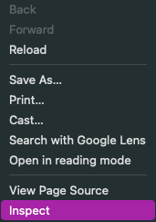
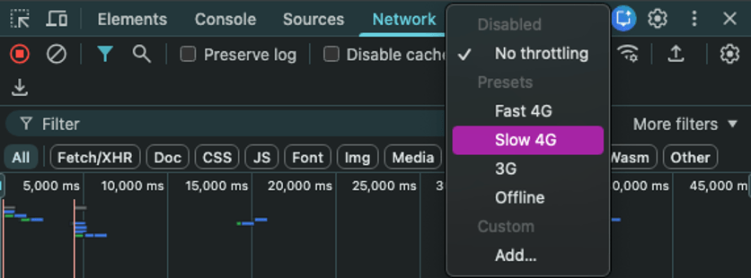
Simulating poor network
2
3
1
In Google Chrome on a laptop:
right-click on the website you want to test, a menu will appear, select ‘Inspect’
a window will appear, in the top menu, select ‘network’
change the menu for speed and simulate the network’s speed you want
Notes:
To see how your website behave with poor network, you can use google chrome dev tools and simulate this.
You don’t need to be a dev to try this:
in google chrome, on your laptop, open your website.
click right anywhere on the page. A menu will appear and you select ‘Inspect’ - This is giving you access to the Chrome Dev tools
This will open a window, and within it, there is the item ‘Network’ when you select it you will find a drop down list where you can select different network speeds which will be simulated and you will see how long things take to load on your website.
This is interesting to do regularly on various pages to get a feel on how people experience your website in these conditions and then see how you can improve this.

Slide 36
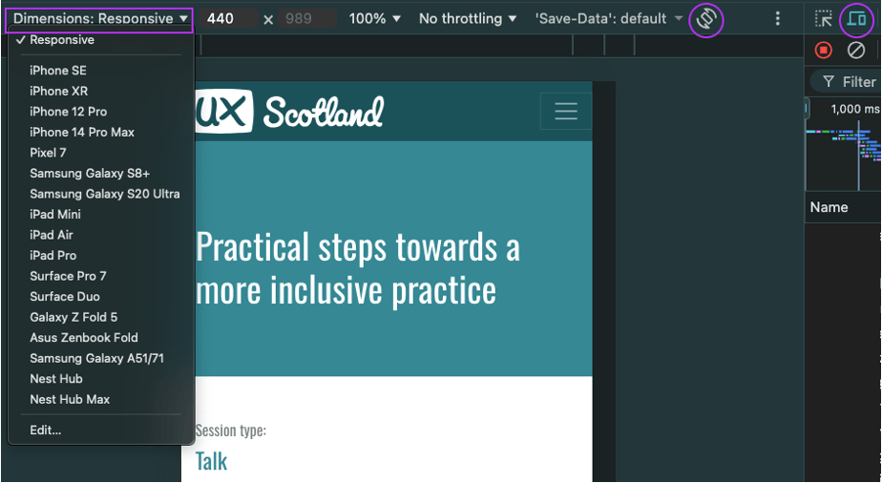
Test for mobile view
1
2
in the top menu; at the start, select the icon looking like a mobile in front of a big screen
another view of your page will appear with a menu at the top, under ‘Responsive’ select a view of the device you want
you can even rotate to change from portrait to landscape view
3
Notes:
Another thing you should test, is how it works on mobiles and small screens. Ideally you should test on many devices, but you can simulate it for free using Chrome dev tools again on a laptop
in the top menu; at the start, select the icon looking like a mobile in front of a big screen
another view of your page will appear with a menu at the top, under ‘Responsive’ select a view of the device you want
you can even rotate to change from portrait to landscape view

Slide 37
Resources about digital inclusion
Digital Inclusion Action Plan - GOV.UK Feb 2025
Lloyds’ UK Consumer Digital Index 2025
Good Things Foundation - Our digital nation
Essential digital skills framework - GOV.UK - useful to assess your participants skills
My demo videos to simulations using Chrome dev tools
Notes:
Do go back to the slides for the instructions and try this for yourself. I’ve made some video demos, which you can access with the links for the slides The rest are resources to understand digital inclusion a bit more.

Slide 38
A more inclusive practice
Notes:
Accessibility and digital capability are part of inclusion, but there is more to it

Slide 39
A more inclusive practice:
Common inclusion issues
Notes:
I’m going to start by mentioning some common inclusions issues

Slide 40
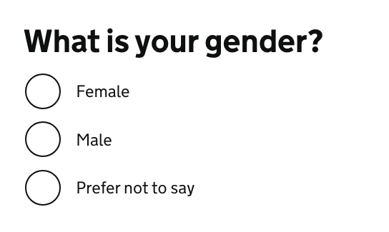
Gender and ethnicity
Problem:
asking in a way that doesn’t allow you to identify yourself correctly
Solution:
do you really need to ask?
research / test with your users
Notes:
A classic is asking about your gender or ethnicity in a way that do not allow you to identify yourself correctly.
For example on this slide, the question is asking for your gender and only considering Female or Male as options to choose from, with an additional option which says ‘Prefer not to say’.
To avoid excluding people in this scenario, you should first question if you really need to know about the gender or the ethnicity of your user.
In many cases you actually don’t! so this could be one less question and one less source of exclusion.
If you do need this information, you need to research and test with your users
GOV.UK Design system: Ask users for Gender or sex
GOV.UK blog post - Researching how we ask users about their ethnicity

Slide 41
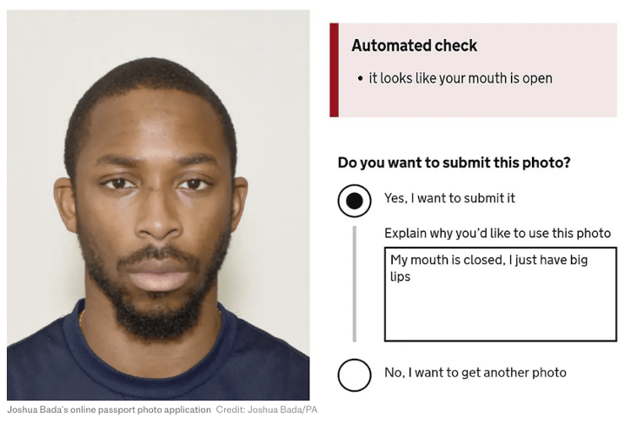
Only considering white people
… when testing your product
Artificial Intelligence to test if a photo is valid for example
Or the ‘racist’ soap dispenser only working on white skin
Notes:
You might also have been only considering white people in your testing.
For Black people and afro hair, your photo might be rejected even though you respect the rules
because the AI has been trained only or mostly with photos of white people.
There is a link to 2 articles about this in the notes. One of them includes the photo of a Black man I’m using on this slide which generates an error message stating the it looks like your mouth is open even though he is respecting the rule and has his mouth closed.
Or you might remember a video which was doing the rounds a while ago with a soap dispenser only working on white skin. There is a link to a video about this in the notes too.
Like for accessibility, testing with a wide range of people should help preventing the exclusion of people using your service in ways you might not have realised.
Black man says racially-biased AI system rejected his passport photo - the next web article
'Racist' passport photo system rejects image of a young black man despite meeting government standards - The Telegraph
This 'Racist soap dispenser' at Facebook office does not work for black people - YouTube video

Slide 42
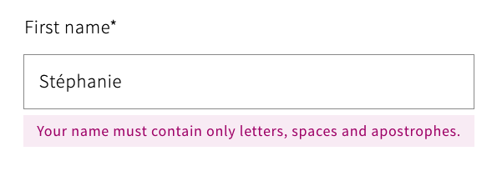
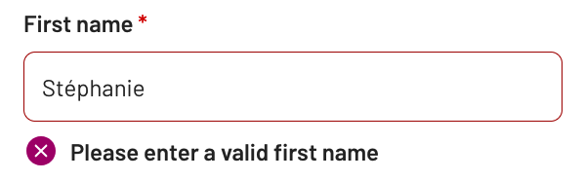
‘Your name is not valid’
Too short, too long, too many, special character and more …
Notes:
Another classic to avoid is excluding many name in your inputs. If you are curious about names validation, I’ve put the link of an article by Patrick McKenzie about lots of things you might not know about names.
Falsehoods Programmers Believe About Names - Patrick McKenzie

Slide 43
A more inclusive practice:
Illustrations

Slide 44

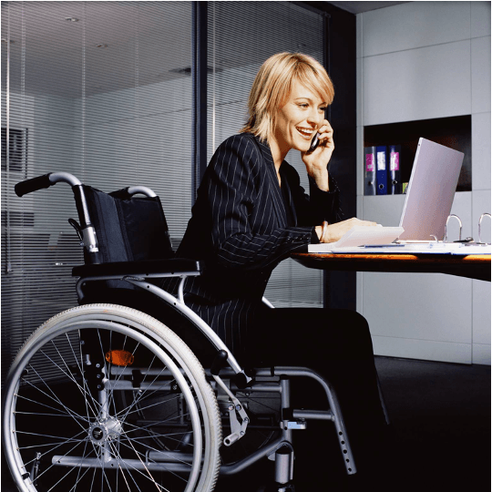
Be careful with illustrations
Notes:
I want to mention illustrations. Try to be intentional in your illustration choices, but be careful.
The photo on the left of this slide is from a LinkedIn post from Meryl Evans, she is deaf and was posting, that quite often, people illustrate articles about deaf people with a person signing, even though a lot of deaf people actually do not sign.
And then most of the times, the sign on the photo is the one on this slide where a person make a thumbs up with one hand and put it in the flat palm of the other hand. This sign means ‘Help’. Using this sign as an illustration, means that quite often, the person is shown as needing help, so not the best message as it represents deaf people as if they always need help.
A lot of photos of people at work in a wheelchair also don’t seem to be real wheelchair users, like the photo on the right of this slide, showing a young woman in a suit, using a heavy wheelchair which looks more like what you would find in a hospital where another person is pushing it, rather than the model that someone who uses wheelchairs independently for mobility would have.

Slide 45
Resources: Inclusive photos
Allgo - Free Plus-Size Stock Photos
Positive and realistic depictions of later life - Centre for ageing better
Stock photos of people with disabilities - Webaxe
Free Stock Images Of Our Community At Work - Jopwell
Nappy - Beautiful photos of Black and Brown people, for free
UK Black Tech - Free Stock photos
Notes:
To help you find photos, I have a list of resources on this slide and they are free.

Slide 46
A more inclusive practice:
Your team
Notes:
In the next part, I’d like to focus on inclusion within your team.
I think that the best way to have inclusion in mind for your users is to start to really change the way you work with your own team and your stakeholders, as you work with them every day.

Slide 47
There are no disabled people in my team
→ many disabilities are not visible
→ people sometimes don’t declare their disability
Neurodivergence in tech / creative industry:
→ over 20% - probably up to 50%
Notes:
You might be thinking, what is she on about? there are no disabled people in my team or among my stakeholders. And maybe you’re right.
But the problem is that people often think of disability as something that is visible and permanent.
Do you remember the statistic for neurodiversity? about 1 in 7 people in the general population but in tech and creative industries, it might be up to 50%
This is not visible. You might not know about it, but you surely should think about it.
Another thing to keep in mind is that people sometime don’t declare their disability to their employer/colleagues
For lots of different reasons.

Slide 48
Things can change
actual employees can become disabled
you want to be able to hire disabled people
→ Make sure your systems, processes and practice are accessible for all

Slide 49
Creating a safe space
Do not force people to disclose a disability or medical condition
→ offer help for everyone
Instead of providing accommodations for disabled people
→ offer various options to all
Invite for feedback and allow people to reach out privately
Notes:
It’s important to create a safe space. Don’t force people to disclose a disability or medical condition. Instead, offer help for everyone.
We talk about ‘accommodations’ for disabled people, but it’s better to offer various options to all instead, so it doesn’t sound like you are making a big effort just for them and that way, it will benefit more people who might not have requested anything even though they might need it.
Invite for feedback, and allow people to reach out privately: it’s not always easy to talk about your needs in public, or in a group during a meeting.

Slide 50
Manual of me
Examples of sections:
condition I like to work in
time and hours I like to work
best way to communicate with me or provide feedback
things I’m good at
things I might need help with
how I like to be helped
help you tell others what you need
learn about what other people in your team needs
Do not make people share more than they are willing to
Notes:
A ‘manual of me’ can be a great tool to communicate what you need to work well with the rest of your team. I’ve been doing this in project teams for a while and found that it helps me to tell people what I need and also to understand them better.

Slide 51
Resources: Inclusion within your team
Inclusive meetings: encouraging collaboration from all – Co-op Digital Blog
Manual of me
Inclusive icebreakers – by Lizzie Cass-Maran
Quick icebreakers for online meetings (that don’t suck) - Emily Webber
Notes:
A few resources on this slide to be more inclusive with your team. Two of them are about icebreakers as they are quite often pretty bad in terms of inclusion, especially for neurodivergent people.

Slide 52
A more inclusive practice:
Meetings
Notes:
Meetings! This is very important and something that is often not done well

Slide 53
Organising - hosting a meeting
before the meeting: set expectations, provide an agenda, do it again at the start of the actual meeting
invite people to tell you if this might not work for them
if using online tools like Mural or Miro, plan for an alternative
if over an hour → plan for a break and stick to it
repeat the question someone asked before answering unless you’re sure everyone has heard/seen it

Slide 54
Presenting during a meeting
share your slides at the start of a presentation or in your invite
keep content short and simple
use a mic, speak facing your audience, camera on if online
leave some space at the bottom of your slides
describe any image/ diagram, assume at least one person cannot see
don’t assume people can read the text on slides

Slide 55
Resources: Creating accessible slides
How to make your presentations accessible to all – W3C resource
Presentations – Readability Guidelines – by Content Design London
Make your PowerPoint presentations accessible to people with disabilities – Microsoft support
Create better conference slides and presentations – Stephanie Walter
Notes:
if you are not too sure about how to make your slides accessible, I’ve put a lot of resources on this slide

Slide 56
Resources: Inclusion in general
A beginner’s guide to inclusive UX design by Trina Moore Pervall
The practicalities of inclusive service design by Fiona McAra-Hunter
Inclusivity and content design, YouTube video by Content Teatime
On inclusive content: Fighting talk by Ettie Bailey-King
Liberating Structures – new website
Notes:
and to finish this section about inclusion, I’ve put more general resources here. The last link is about liberating structures, which is a great way to change the way you facilitate activities, and allow for more voices to be heard. It’s really good and if you do not know about it, you should have a look.

Slide 57
Focus on some groups
Notes:
In this last section, I’m going to tell you about a time where I focussed theresearch on a few groups which gave us the most valuable insights.
Convincing stakeholders to do user research is usually not easy. You will be tempted to do your research on the main groups of users and what you might see as an average user.
If you remember at the start, I mentioned that 1 in 4 people is disabled in the UK. You should have a similar proportion in your research participants.
But I think you could go further, you could focus your research on the people most likely to struggle with your service:
the idea is that, if it works with the people facing the most barriers, it’s very likely to work with the others

Slide 58
Context
Housing application for a council in Scotland
a complex form to test to apply for council housing
no budget for user research
very little time before going live
Notes:
I’m going to tell you about a project where I was part of a small team working on a housing application for a council, early in my design career

Slide 59
Who was most likely to struggle with the form?
People:
who did not have English as their first language
with low digital skills
at risk of homelessness
low vision or other disabilities
Notes:
Normally, recruiting people with these characteristics would have been hard, but we had access to a community support worker.
He had worked for the council for a long time, he knew a lot of people and was very involved and trusted,
he wanted to help us because for the first time, we were asking people to tell us what they thought would work or not before going live and he really like that.

Slide 60
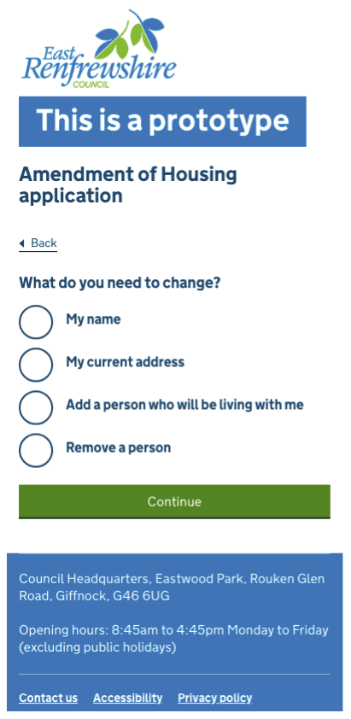
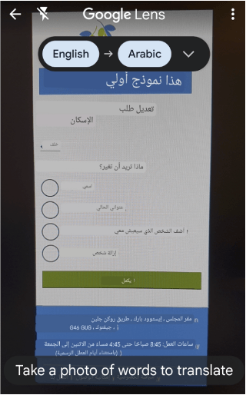
2 rounds of testing
Syrian refugees + interpreters
low digital skills
people at risk of homelessness
one teenager + their support worker
Notes:
Our community support worker found people for us in no time.
Participants were happy to help
We organised 2 rounds of testing. Our participants were:
Syrian refugees part of a resettlement scheme who didn’t speak English as their first language - We had interpreters with us which was really helpful, but some participants wanted to try by themselves and used Google lens to translate the interface, they were using their phone and placing it in front of the screen and Google lens would show them the Arab text instead of English automatically, it was quite impressive and helping them
participants had low digital skills, in fact, most of the Syrian refugees never had an email address before coming to the UK
We also had people at risk of homelessness,, one was a 16 years old who came with their support worker

Slide 61
Takeaways for the housing application research
should have had an ethic plan + be trauma informed
having a trusted relay in the community really helps
testing with only a few people still gave us a lot of insights
be careful with support workers and interpreters
In some cases, it might be ok not to provide incentives to participants
Notes:
Knowing that I would be speaking to people in vulnerable situations like refugees and people at risk of homelessness, I should have been better prepared, I wasn’t and was lucky it worked ok for everyone. Now that I’m more experienced and I would do it differently. I should have had an ethic plan and I should have made sure that people involved - like my observers - were trauma informed.
The community support worker made a huge difference to the recruiting, so having a trusted relay in the community was key - if you can have this, do use it.
We got a lot of insights with only two rounds of research. For example, we realised that we needed a triage question quite early on, so that homeless people would not go through the form, instead we gave them a phone number to contact the council where they would get support quickly. This simplified the form a lot.
You need to plan when you have another person answering, like the support worker for our teenager participant, or the interpreters for the Syrian refugees
You need to explain how you work before the session, and clarify what you need from them so they don’t answer instead of the participant or give too much info for example.
Regarding providing incentives to participants of your research and to their support workers or interpreters.
In this case, the support worker for the teenager and interpreters were doing this as part of their jobs, so they were paid by the council, but we didn’t provide any incentive to the participants.
Most of them seemed really happy to help as, in a way, it was an opportunity for them to give back to that community support worker, and also a way to try the form and train on it before doing it for real once the form would go live.
But it could have been different, so it’s worth discussing potential incentives early in your project and planning a budget for this.
Focussing on these groups was possible and worked for me at the time.
It might not be right for you, but I’m sharing this as it might be an option you would not have thought of otherwise.

Slide 62
Resources about research
Designed with Care: Creating trauma-informed content
Working definition of trauma-informed practice - GOV.UK
Building UX research practices for inclusion by Josh Kim and Maureen Barrientos - YouTube video
Citizen Advice
User research with disabled people and their families - Scope
Inclusive user research: vulnerable people - Tetralogical

Slide 63
Key takeaways

Slide 64
Accessibility takeaways
1 in 4 person are disabled
1 in 7 person are neurodivergent
most issues are easy to fix, like adding alt text, checking colour contrast and making sure the text of your link is meaningful
do not rely on colour alone to convey meaning
2 tests: keyboard only and zoom 400%
be careful with numbers
do NOT use accessibility overlays!

Slide 65
Digital capability: device - network
Make it work when the network is poor
Mobile first
Test on old devices
Offer alternative channels

Slide 66
Digital capability: data
provide a file’s link instead of only an option to download it
if not possible, provide the size of this file
keep image files big enough so the quality allows to see them well, but small enough that it doesn’t use too much data to load
→ it’s a balance to have between accessibility and digital inclusion

Slide 67
A more inclusive practice takeaways
be careful with how you ask about ethnicity, sex and gender
make sure you are not excluding valid names
do not only test with white people
be intentional with your illustrations

Slide 68
To improve inclusion in your team
do not assume there are no disabled people in your team
consider neurodivergence and low numeracy in particular
be careful with ice breakers and use manuals of me
use accessibility checkers for your slides and word documents
send your presentation ahead of the meeting

Slide 69
Thank you!

Slide 70
Some of my blog posts
Different levels of inclusion awareness
Inclusion in the workplace
Avoiding misconceptions on your accessibility learning journey
Removing barriers to inclusion
Advice for speakers (to present in an accessible way)
Is my website accessible?

Slide 71
Any question?
Get in touch: stephanie.krus@proton.me

